Slide 1
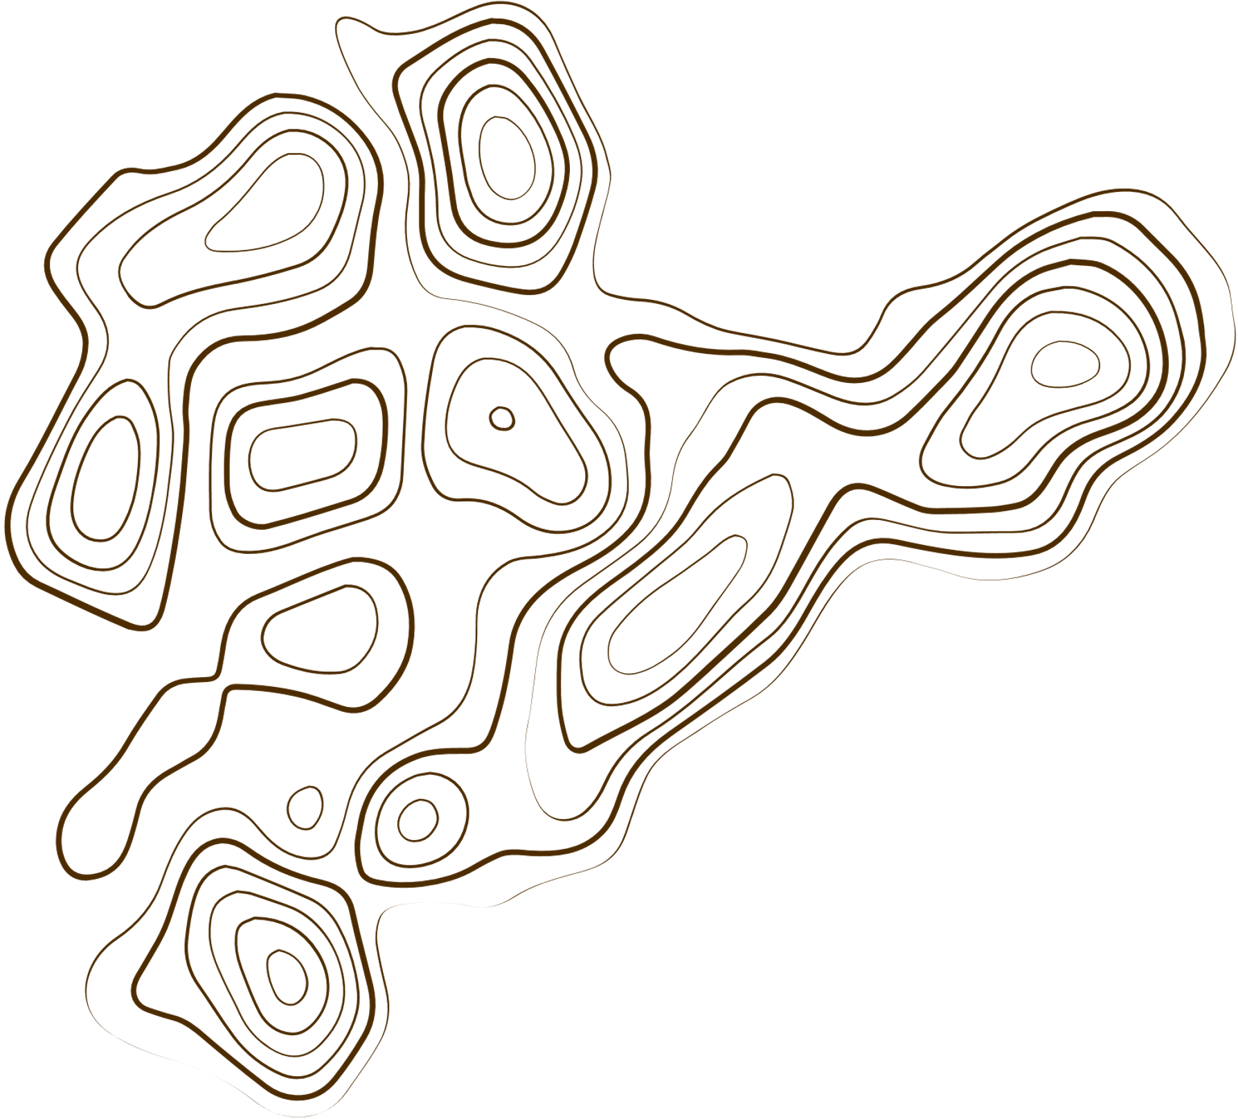
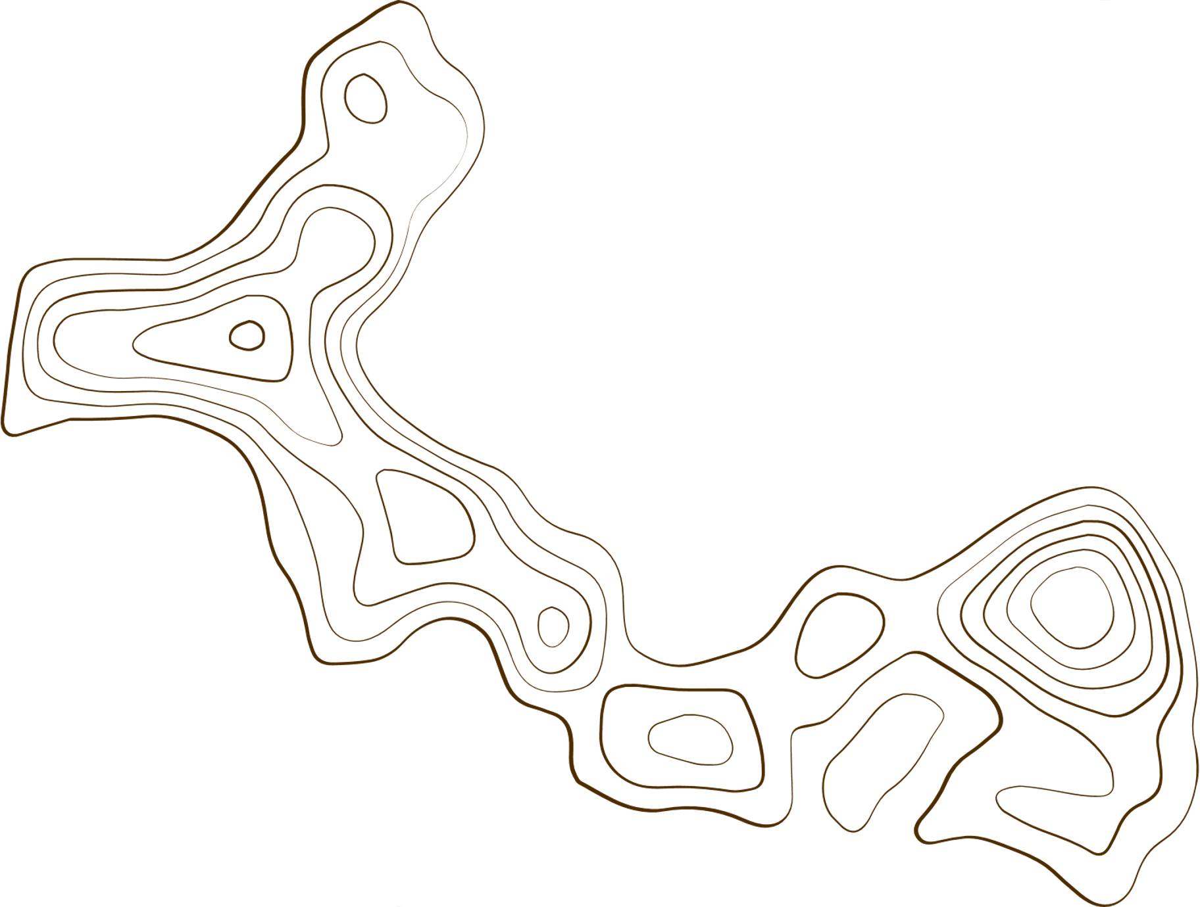

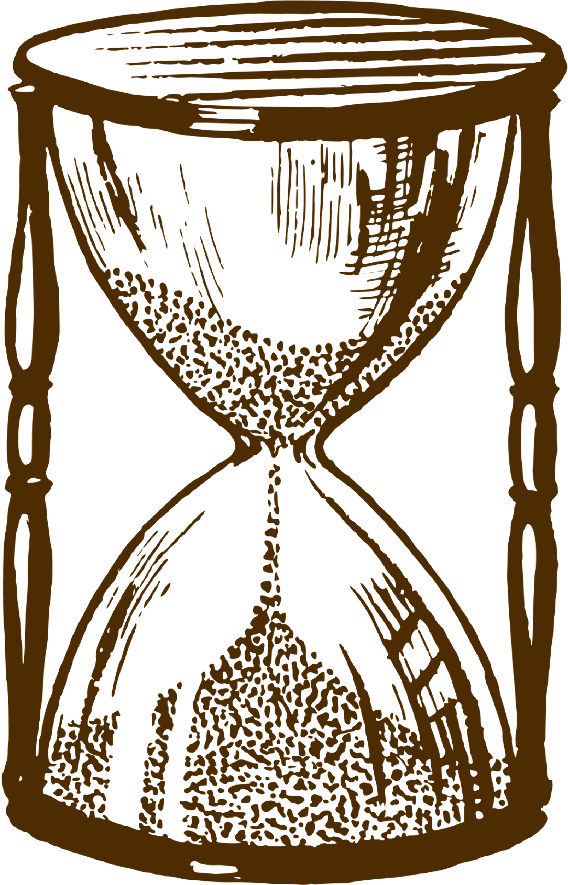
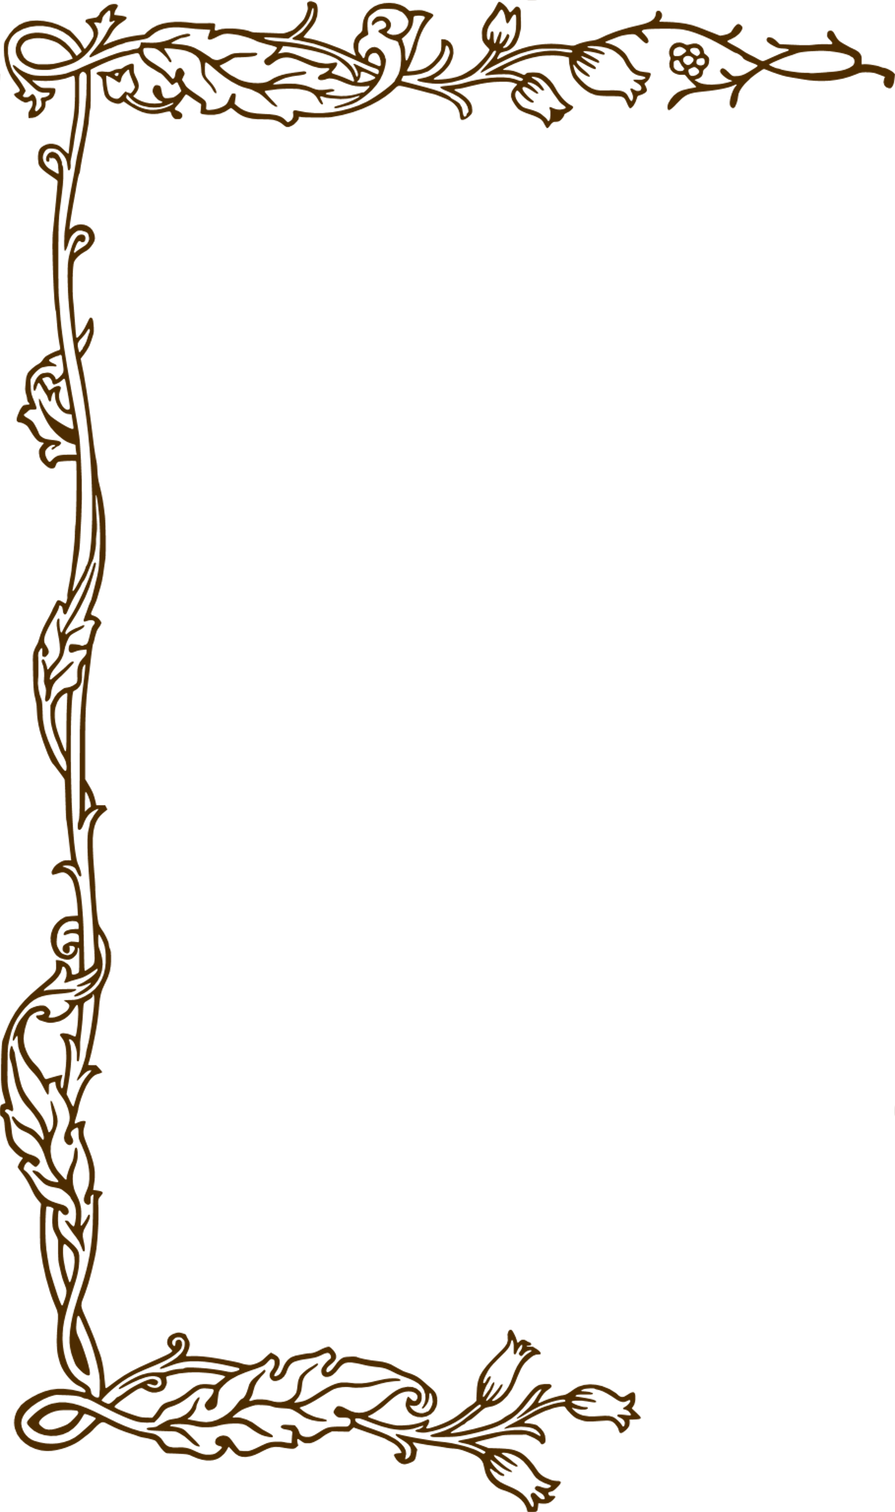

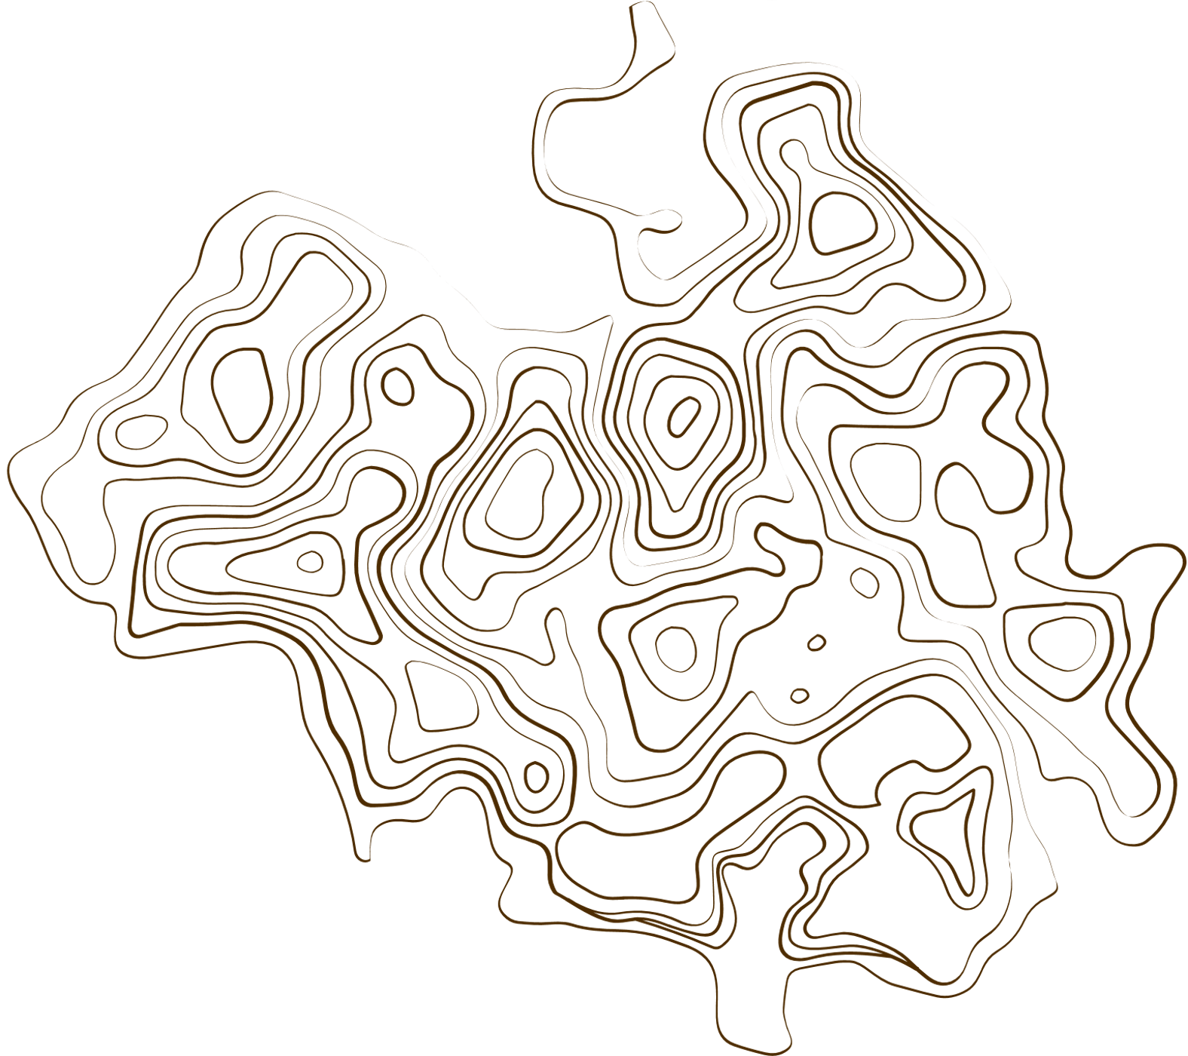
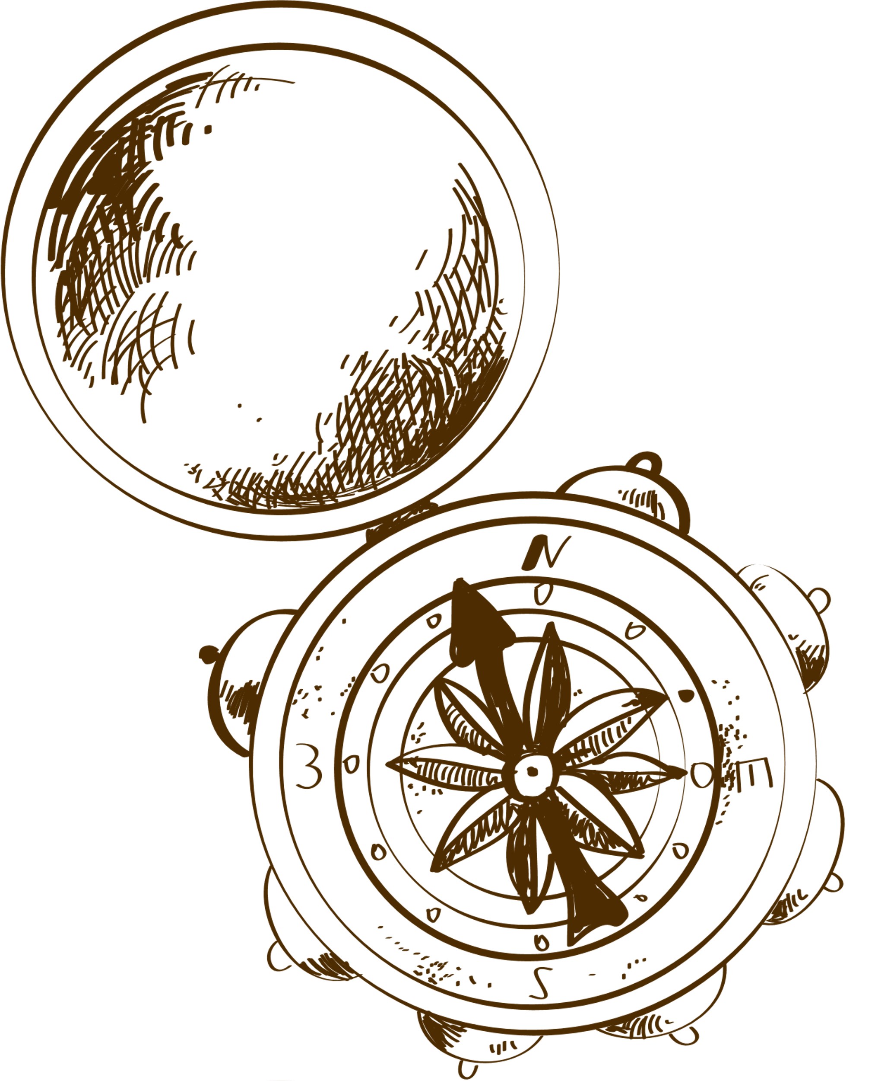
Authorship attribution
Barbarasa Maria-311
Ignat Mihaela-311
Oproiu Matei-311

Slide 2


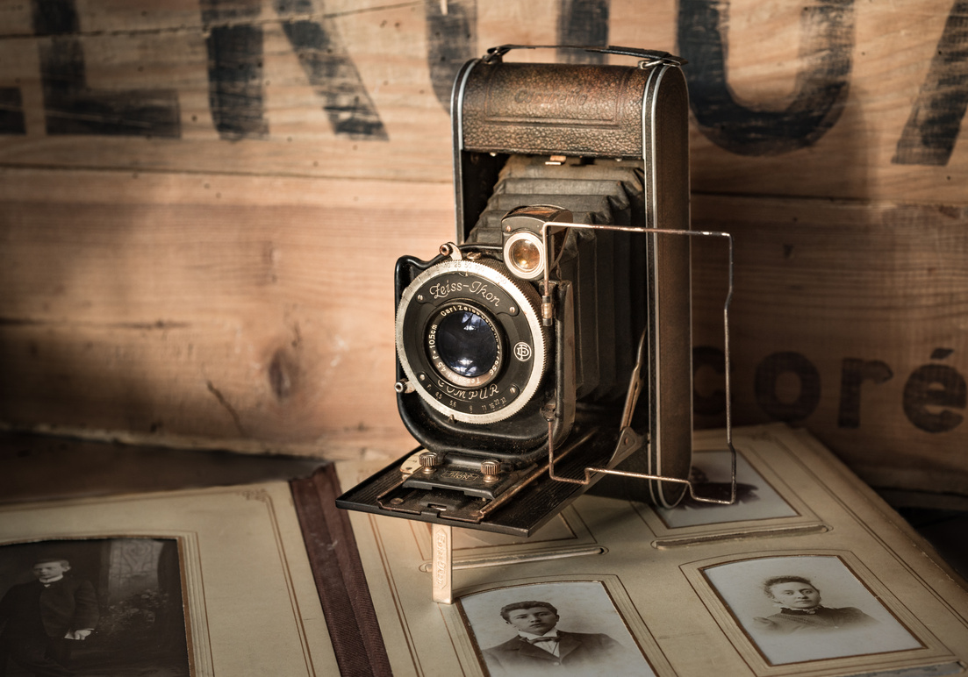

Content
Web Scaping
Bag of Words + the Multinomial Naïve Bayes
TF-IDF vectors + Cosine Similarity

Slide 3
Content
Paper Comparasion

Slide 4
Introduction
In the domain of Natural Language Processing (NLP), authorship identification represents a compelling and intricate challenge.
For this project, we have opted to explore Romanian poetry, renowned for its rich, expressive, and nuanced language, which provides an excellent case study for this type of textual analysis.
Our objective was to investigate the efficacy of various NLP techniques in discerning distinct poetic styles, thereby determining how effectively these methods can attribute a given text to its rightful author based on linguistic patterns and stylistic features.

Slide 5

Web Scraping
For the web scraping component, we chose to use an application called ParseHub.
It's a powerful visual scraper that is ideal for extracting data without the need for writing code.
We opted for this tool because it allowed us to navigate the desired website and automatically extract the required data.
By using this application, we were able to collect multiple authors along with their poems and store them in JSON files.

Slide 6
METHOD 1
Bag of Words + The Multinomial Bayes Naïve model

Slide 7
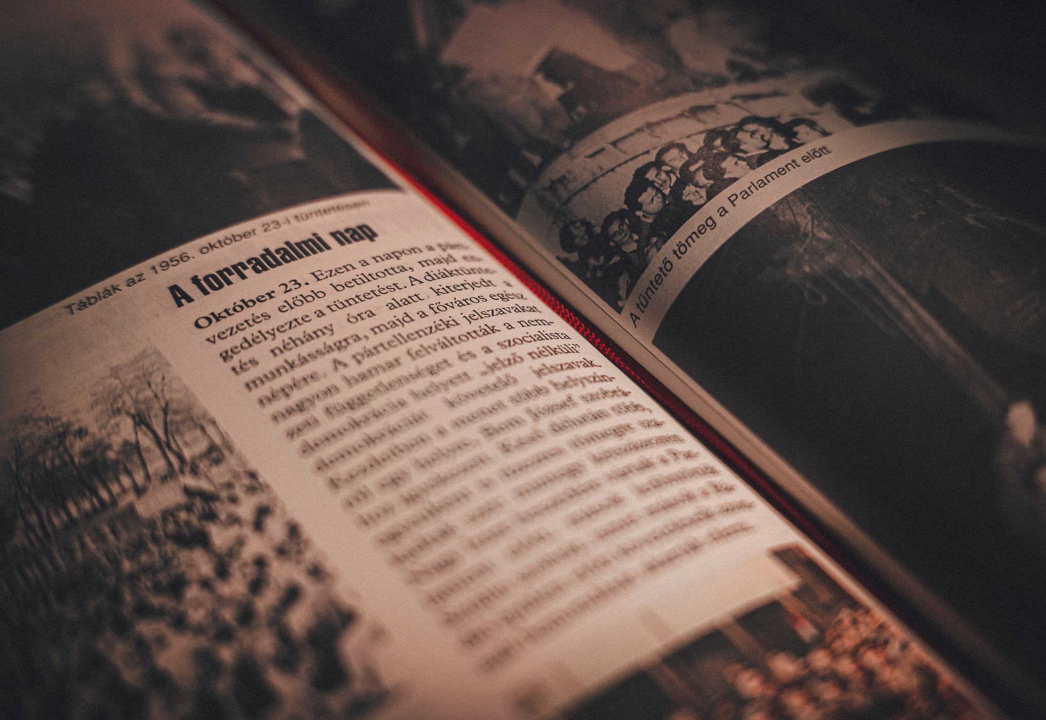
Bag of Words
Bag of Words (BoW) is a fundamental text representation technique used in Natural Language Processing (NLP);
It transforms a text into a numerical vector, where each word from a predefined vocabulary is represented by its frequency within the document;

Slide 8
The Multinomial Naïve Bayes model
Our code implements a poetry authorship identification system using the Multinomial Naive Bayes model :
The Multinomial Naive Bayes model constructs a vocabulary with all unique words and calculates the frequency of each word in every class.
Bayes' Theorem is applied to determine the probability that a document belongs to a specific class based on its words.
We chose this model because it is fast and efficient, works well with large datasets, and relies on word frequencies, which is exactly what the Bag of Words (BoW) approach provides.
.

Slide 9
Analysis of the code
Loads poems from JSON files and groups them by author.
Preprocesses the text by removing special characters and converting it into a list of words.
Builds a unique vocabulary with all distinct words from the corpus (Bag of Words).
Represents each poem as a numerical vector using the BoW model.
Splits the data into 80% for training and 20% for testing.
Trains a Naive Bayes model on the training data.
Evaluates the model's accuracy on the test set.
Allows the user to input a poem fragment, which is transformed into BoW, and then the model predicts the author.
Saves the results in a CSV file.

Slide 10
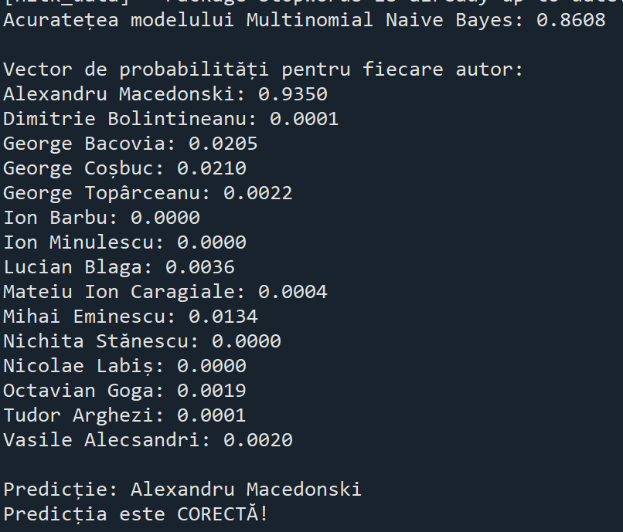
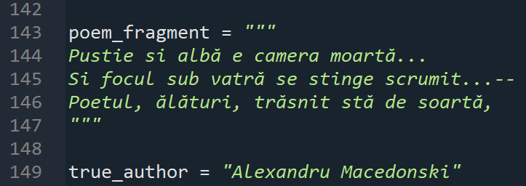
Input
Output

Slide 11
METHOD 2
TF-IDF + COSINE SIMILARITY

Slide 12
TF-IDF METHOD
TF-IDF (Term Frequency - Inverse Document Frequency) is a numerical representation of text documents;
This method allows highlighting the most relevant words in a document by considering both their frequency within the document and their rarity across the entire document;

Slide 13
COSINE SIMILARITY
Cosine Similarity calculates the angle between two vectors in an n-dimensional space.
The closer the angle is to zero, the more similar the vectors (documents) are.

Slide 14
Analysis of the code
Extracting Data:
-Retrieve the poem text, title, and author name from each JSON file;
-We store them in a Pandas DataFrame( for efficient processing);
Convert to Numerical Representation: Transform the poems into numerical vectors using the TF-IDF method before performing text comparisons;
Apply the Cosine Similarity formula on the test poem and compare it with the poems in the dataset;

Slide 15
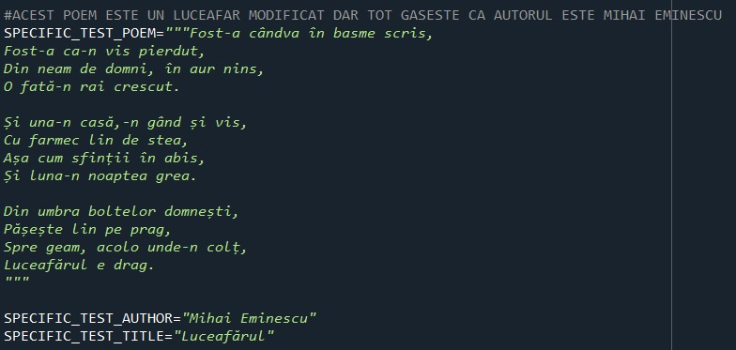
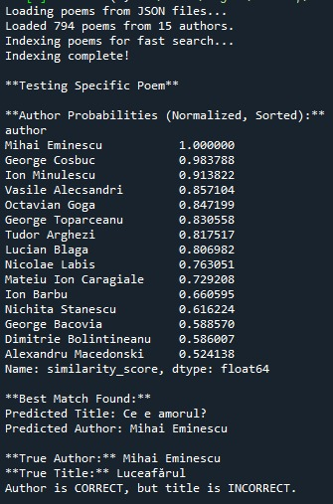
Input
Output

Slide 16
Comparasion with another paper
The work chosen for comparison is titled "Authorship Identification of Romanian Texts with Controversial Paternity". It focuses on answering a literary issue: is the sequel to the novel "Under the Seal of the Taina" written by Mateiu Caragiale or Radu Albala? This dilemma is framed as a stylistic attribution challenge with literary ramifications. The goal is to identify the author based on objective stylistic features.
Instead, we tackle the author attribution problem from a broad NLP perspective, as applied to Romanian poetry. It does not look into a specific example of disputed authorship, but rather evaluates the effectiveness of certain basic approaches for classifying poetry based on authorship.

Slide 17
Comparasion
Type of text analyzed | Prose | Poems
Accuracy | 62.56% (Caragiale), 50.56% (Albala) | ~90% (TF-IDF), ~80% (BoW+NB
Number of authors | 2 | Multiple authors
Techniques used | SVM with string kernels | TF-IDF + Cosine Similarity, BoW + Naive Bayes
Experimental validation | Leave-one-out cross-validation | 80% train / 20% test

Slide 18
Conclusion
With the addition of both BoW + Multinomial Naive Bayes model and TF-IDF + Cosine Similarity, this project has become more versatile and accurate. It provides a strong foundation for text classification.
Both BoW + Multinomial Naive Bayes model and TF-IDF + Cosine Similarity provide high classification accuracies for this short dataset, and because they are rapid approaches, they can quickly determine whose author the poem belongs to. They are an excellent starting point for learning about Natural Language Processing.

Slide 19
Thank
You

